Slide 1

Introduction to Python
February 7, 2019
Mike Babb, Ph.C.
Department of Geography, UW

Slide 2
Location of this tutorial and workshop material
https://github.com/mike-babb/intro_to_python

Slide 3
Activities
Examine basic python syntax
Using pandas, we will read in data pertaining to the age and sex of the population of Census Designated Places in Washington State during the 2013-2017 time period
Compute the all ages sex-ratio
Export the data to a .csv and an Excel workbook
Merge the sex-ratio data with a shapefile for mapping in a GIS

Slide 4
The Data
American Community Survey, 2013 – 2017
We’ll be investigating the all ages sex ratio for places in Washington State
All Ages Sex Ratio: The number of Males per 100 Females.

Slide 5
Why python?
It’s easy to jump in: https://www.python.org/about/gettingstarted/
It’s cross-platform: Windows, Mac, Linux
It was designed to be simple and readable: https://xkcd.com/353/
It’s free!
It’s popular: https://www.tiobe.com/tiobe-index/python/
It’s prolific: used in many industries for many jobs. Finance, real estate tech, server administration, health care research, non-profit administration
And departments across campus: sociology, economics, civil engineering, astronomy (and geography!)
Many libraries that do pretty much what you want with just a few commands

Slide 6
Brief history about Python
Developed by Guido van Rossum in the early 90s. Current versions: Python 3.7.2 and Python 2.7.15
Python 3.7 is van Rossum’s (and the larger community’s) attempt at fixing some core issues with python 2.x
Integer division returns floats (5 / 2 = 2.5 instead of 5/2 = 2)
Better handling of strings
Better memory management in some cases
It’s a bit faster in general: https://hackernoon.com/which-is-the-fastest-version-of-python-2ae7c61a6b2b

Slide 7
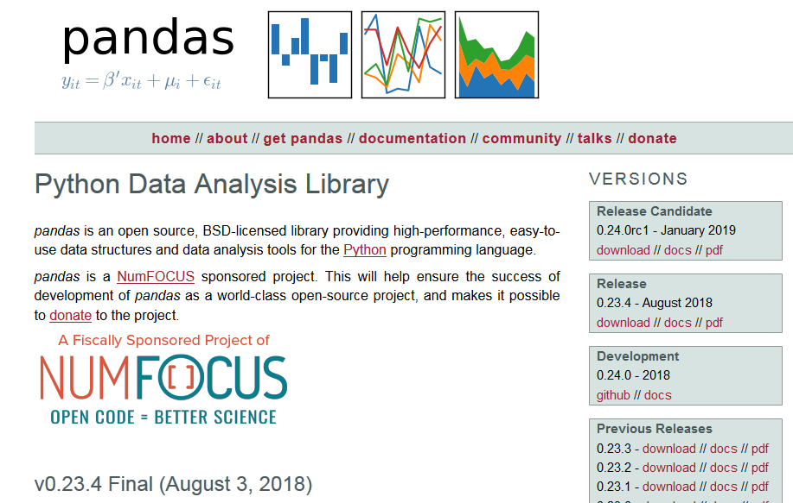
Pandas – Python Data Analysis Library
https://pandas.pydata.org/

Slide 8
Anaconda and the Jupyter Notebook
https://www.anaconda.com/
Available for Mac, Linux, and Windows
THE python data-science platform
Facilitates interactive python
Good for sharing and instruction
Easy to break code into manageable chunks

Slide 9
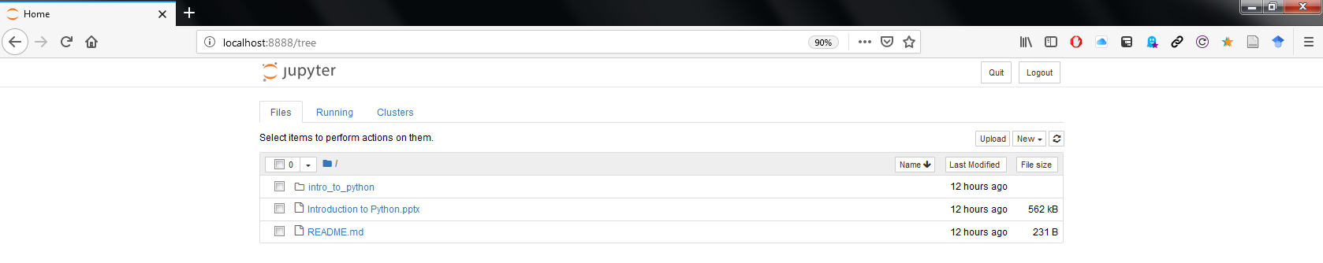
Jupyter Notebook Homepage

Slide 10
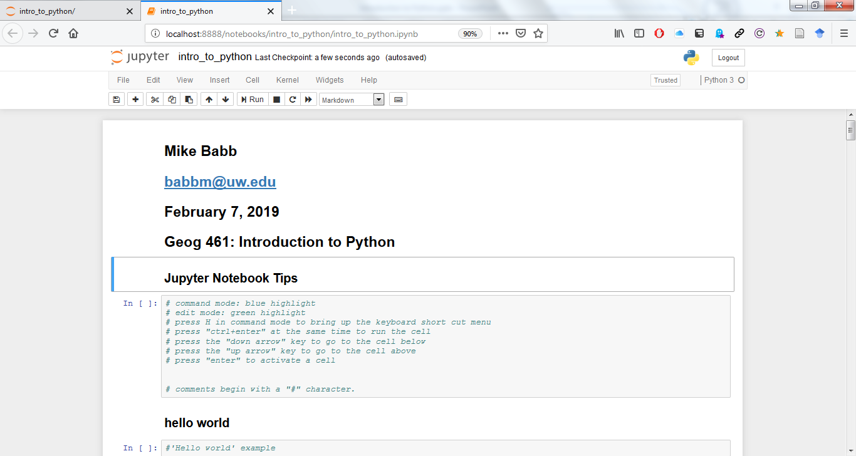
Jupyter Notebook Terminal

Slide 11
Finally… Python or R?
Both

Slide 12
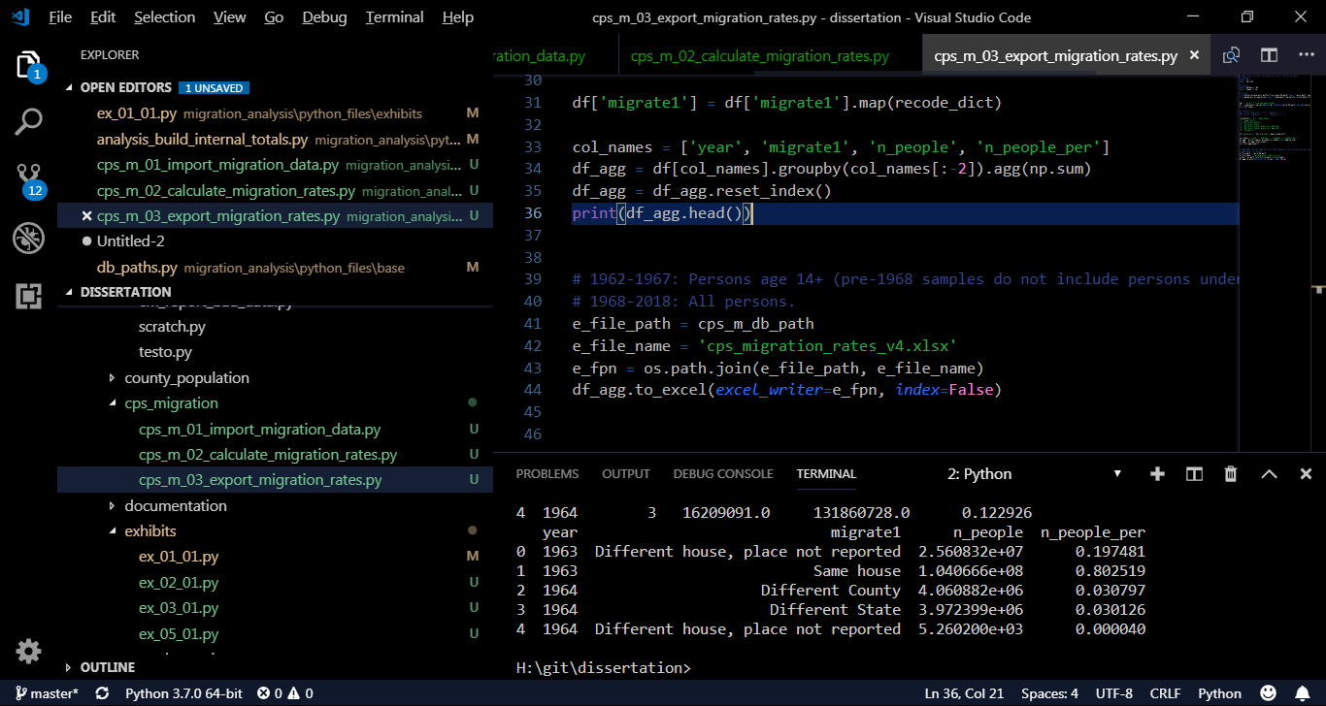
Python in… Visual studio Code

Slide 13
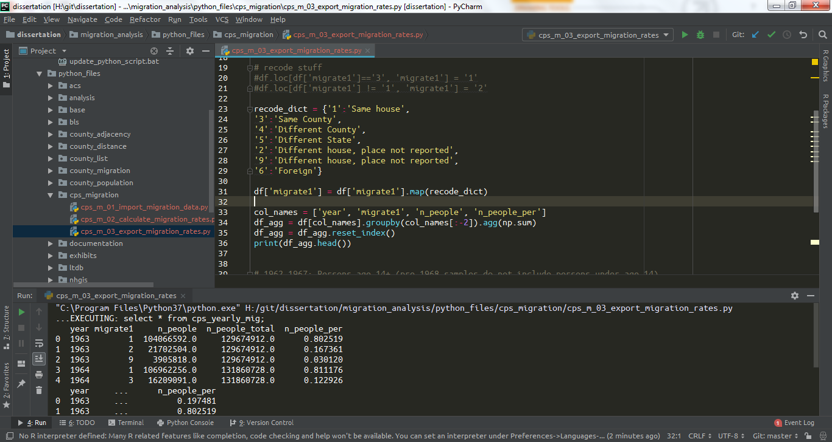
Python in… PyCharm

Slide 14
Additional information on sex ratios
https://www.pnas.org/content/112/16/E2102
https://www.populationpyramid.net/united-states-of-america/2017/
http://science.sciencemag.org/content/297/5589/2008

Slide 15
Data Sources
American Fact Finder
https://factfinder.census.gov/faces/nav/jsf/pages/index.xhtml
Place geography
https://www.census.gov/geo/maps-data/data/tiger.html

